Slide 1

Date: September 14, 2015
To:
Project: Johnson control
Attn:
Recommended Equipment:
- SDC-20-16MDF with RM-6000N
Avani Environmental Intl. Inc.
95 Cypress Drive
Youngsville, NC 27596
www.avanienvironmental.com
Phone: (919) 570-2862
Fax: (919) 570-2863
Email: info@avanienvironmental.com
www.weldingbooths.com
The drawings, AutoCAD, 3-D Models, and specifications are the property of Avani Environmental Intl. Inc. (AE) and may not be reproduced, distributed, modified, or otherwise used, except provided herein, without the express written permission of AE.

Slide 2
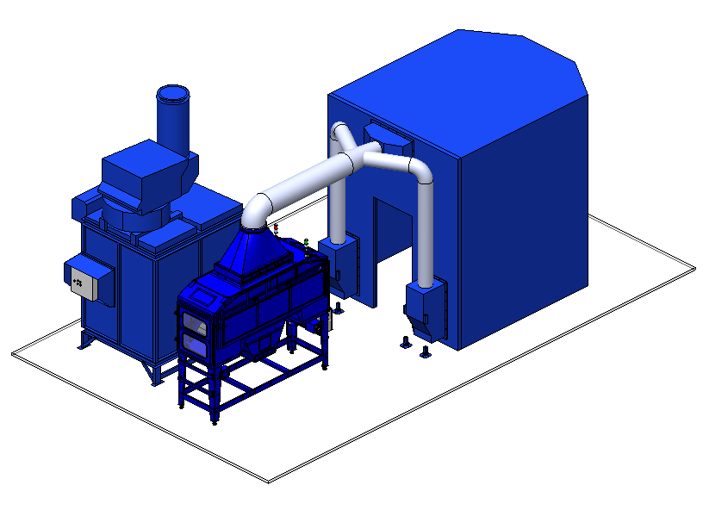
Top Plenum Box
Silencer
SDC-20-16MDF
Bottom Plenum Box
RM-6000 w feet

Slide 3
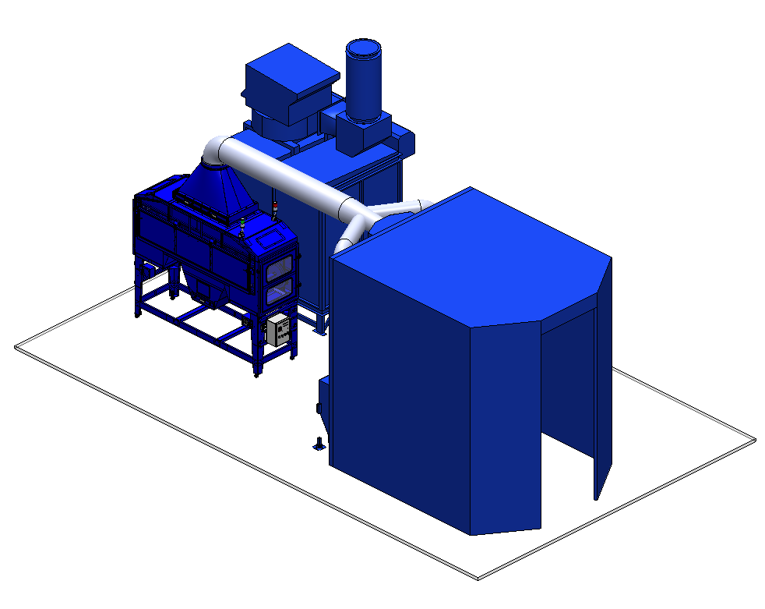

Slide 4
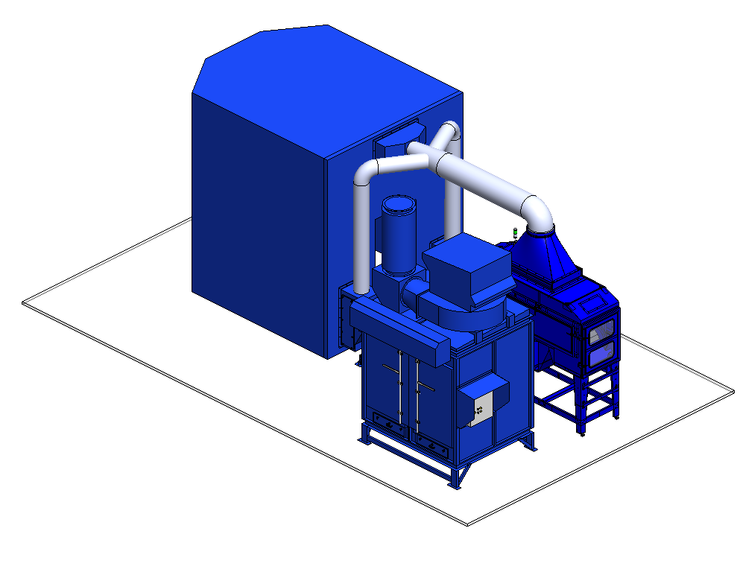
Fume

Slide 5
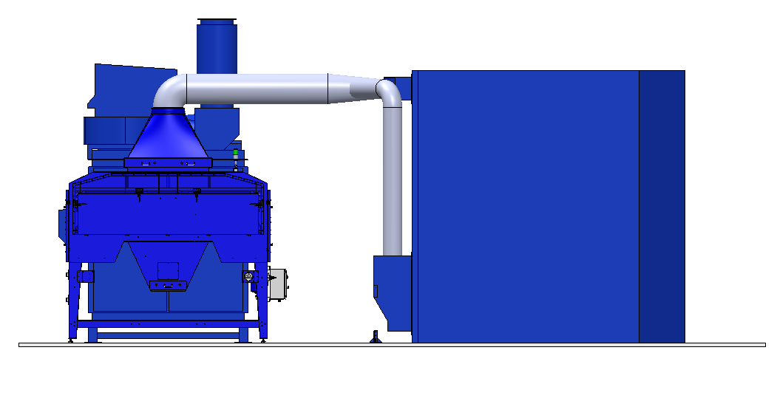

Slide 6
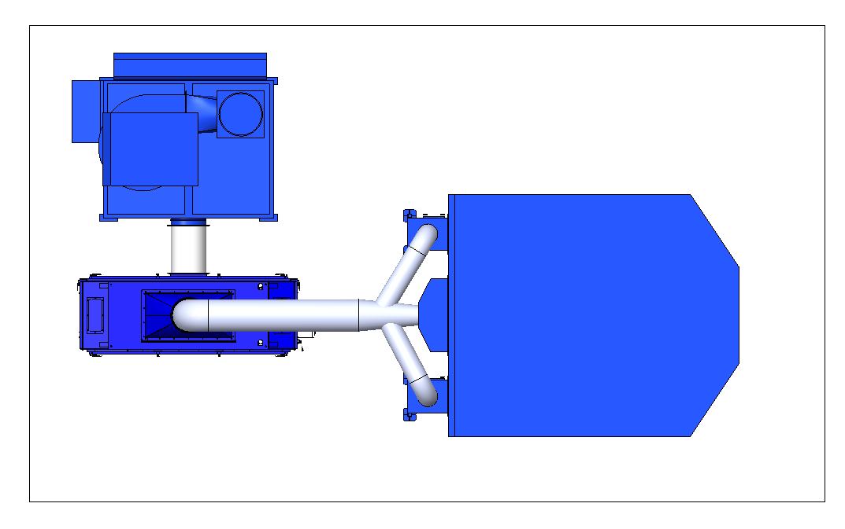

Slide 7
