Slide 1
3RD Gen WB
Grinding Manufacturing Line
A- Smoke 20 / 40
Responsible: Sandoval, Rafael Antonio NP/SMX-PEG

Slide 2
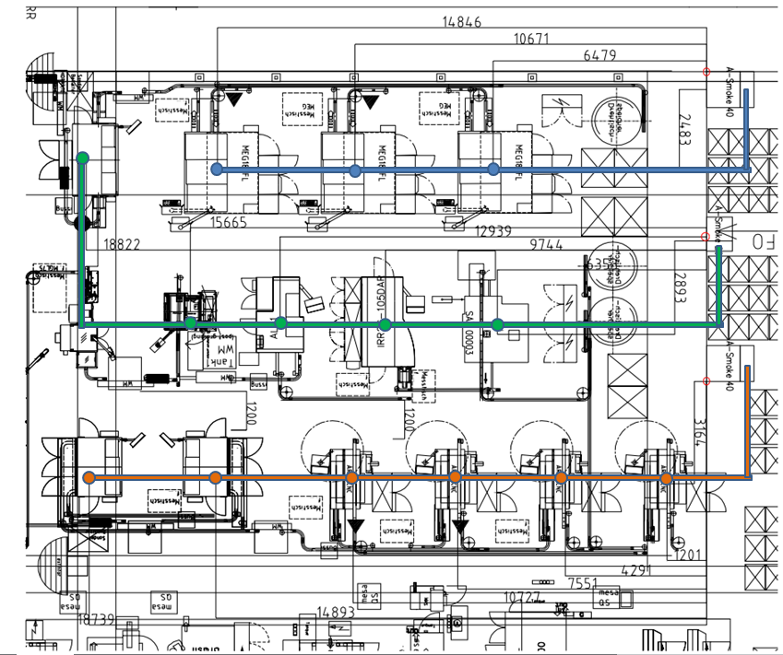
Designation of Grinding Lines
Flange Grinding Line
Inner Ring Grinding Line
Outer Ring Grinding Line

Slide 3
Grinding Medium
Grinding process using emulsion base on water
Grinding and honing processes using mineral oil

Slide 4
Grinding and Honing machines
Grinding machines that produce big amount of smoke
Honing machines that produce very low amout of smoke
Turning machine

