Slide 1
Air Flow Calculations
Calculating CFM based off of Applications

Slide 2
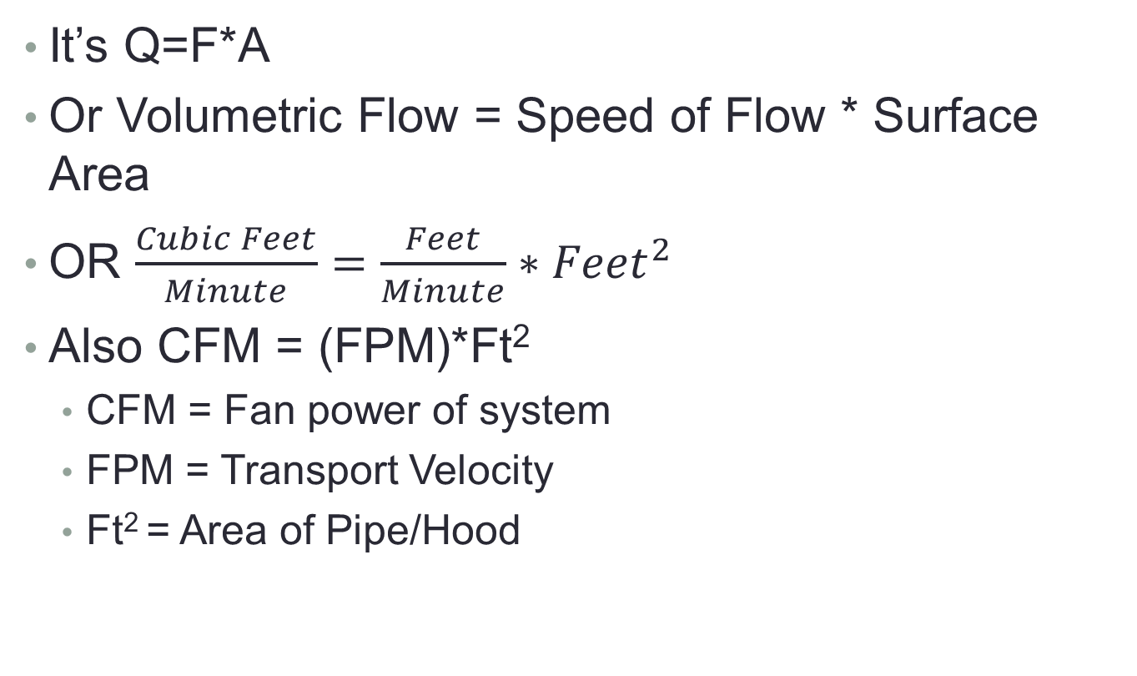
Secret Formula of Air Flow
It’s Q=F*A
Or Volumetric Flow = Speed of Flow * Surface Area
OR $\frac{Cubic Feet}{Minute}=\frac{Feet}{Minute}∗{Feet}^{2}$
Also CFM = (FPM)*Ft²
  CFM = Fan power of system
  FPM = Transport Velocity
  Ft² = Area of Pipe/Hood

Slide 3
CFM of a system
Size the collector of the system based off of what we are pulling from
For Dust Collection
  Fume arms
  Canopy Hoods
  Ambient Air Collection
  Backdraft Panels
  Downdraft Table
For Oil Mist (Absolent)
  Machine outlet/pre-fabricated pickup
  Machine size/door size
  Canopy Hood

Slide 4
CFM draw of Fume Arms
800 CFM for a 6” Arm
1000 CFM for a 8” Arm

Slide 5
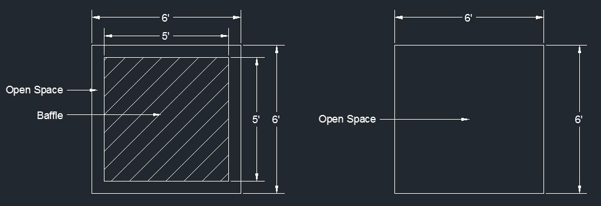
Canopy Hoods
Need to design the Hood to fit situation at hand
Can range by 2’x2’ hood to 15’ x 15’ hood or bigger
Canopy hood CFM = Surface Area of Hood * 100 FPM
If hood is 4’ x 4’ or larger, consider installing a baffle in the middle of the hood, decreasing the open space of the surface area
Example: Calculate the CFM needed for the below hoods to sufficiently collect smoke. View is of the bottom of the hoods.

Slide 6
Canopy Hood Example
Hood on Left
Surface Area = Length (ft) * Width (ft)
SA₁ = 6 ft * 6 ft
SA₂ = 5 ft * 5 ft
SA = SA₁ - SA₂
SA = 36 ft – 25 ft
SA = 11 ft
CFM = SA * 100 FPM
CFM = 11 ft² * 100 FPM
CFM = 1100 ft³
WOW! What large CFM savings!
Hood on Right
Surface Area = Length (ft) * Width (ft)
SA = 6 ft * 6 ft
SA = 36 ft
CFM = SA * 100 FPM
CFM = 36 ft² * 100 FPM
CFM = 3600 ft³

Slide 7
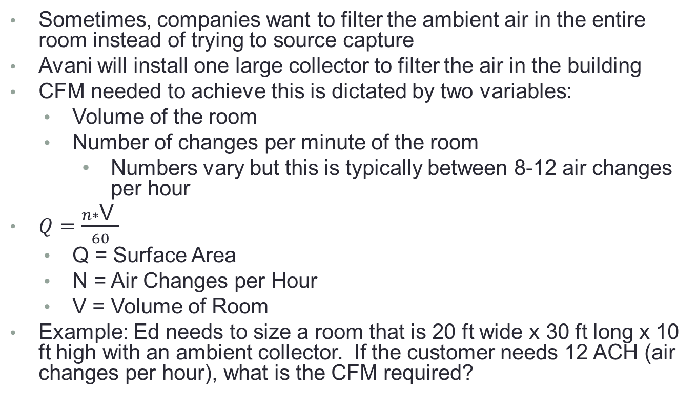
  Ambient Air Collection
  Sometimes, companies want to filter the ambient air in the entire room instead of trying to source capture
  Avani will install one large collector to filter the air in the building
  CFM needed to achieve this is dictated by two variables:
    Volume of the room
    Number of changes per minute of the room
      Numbers vary but this is typically between 8-12 air changes per hour
  $Q=\frac{n∗\text{V} }{60}$
    Q = Surface Area
    N = Air Changes per Hour
    V = Volume of Room
  Example: Ed needs to size a room that is 20 ft wide x 30 ft long x 10 ft high with an ambient collector. If the customer needs 12 ACH (air changes per hour), what is the CFM required?

Slide 8

Ambient Air Collection Example
  $Q=\frac{n∗\text{V} }{60}$
    N = Air Changes per Hour = 12 ACH
    V = Volume of Room = 20 ft x 30 ft x 10 ft
$Q=\frac{12∗20∗30∗10}{60}$
Q = 1200 CFM

Slide 9
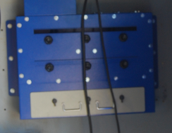
  Backdraft Panels
Backdraft panels are panels in the back of the booth with long thin slots used to pull smoke away from the welder without the use of a fume arm
Assume 1500 CFM to 2000 CFM per booth

Slide 10

Downdraft Tables
Needs 300 FPM throughout entire table surface
Most of table will be covered by grates/slots
Example: A 3 ft by 2 ft table is covered 60% by a grate. What is the CFM needed to sufficiently gather smoke off of the table surface?

Slide 11
Downdraft Table Example
CFM = 60% of Surface Area * 300 FPM
CFM = 3 ft x 2 ft x 60% x 300 FPM
CFM = 3*2*.60*300
CFM = 1080 CFM

Slide 12
Oil Mist – Machine Outlet
Oil Mist is collected from machining centers that typically have exhaust ports that already have been properly sized per the machine requirements
Using the surface area of the exhaust port, we can determine how much CFM is needed to properly exhaust smoke from a machine
Transport velocity of oil = 3000 FPM
Example: If a machine has an 8” diameter connection port, how much CFM is required?

Slide 13
Machine Outlet Example
CFM = Surface Area of Ø8” * 3000 FPM
CFM = (4in * 4in * 3.14)/144 * 3000 FPM
CFM = 0.349 ft² * 3000 FPM
CFM = 1046 CFM
This machine will need to draw around 1050 CFM to sufficiently exhaust the machine

Slide 14
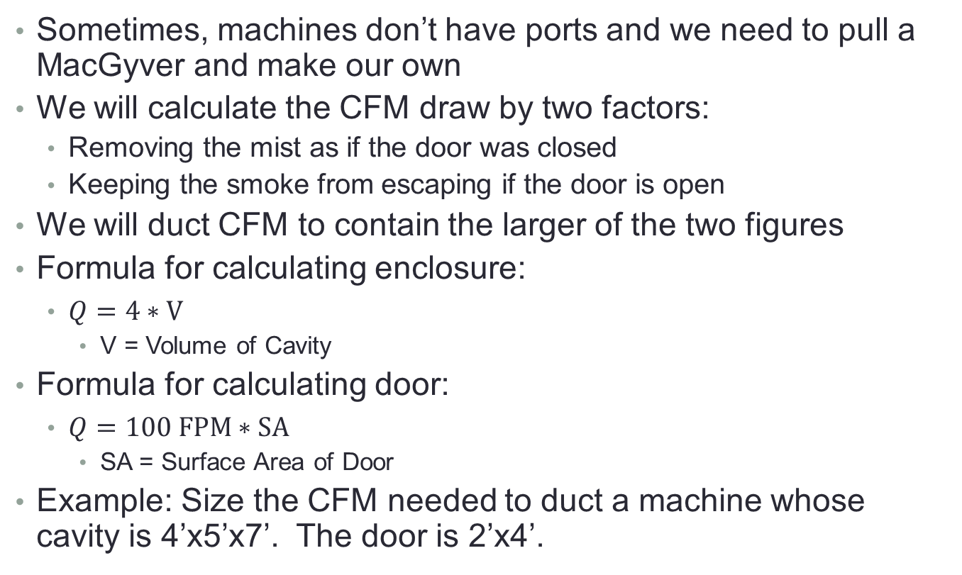
Evaluating a Machine without a Port
Sometimes, machines don’t have ports and we need to pull a MacGyver and make our own
We will calculate the CFM draw by two factors:
  Removing the mist as if the door was closed
  Keeping the smoke from escaping if the door is open
We will duct CFM to contain the larger of the two figures
Formula for calculating enclosure:
  $Q=4∗V$
    V = Volume of Cavity
Formula for calculating door:
  $Q=100 FPM∗SA$
    SA = Surface Area of Door
Example: Size the CFM needed to duct a machine whose cavity is 4’x5’x7’. The door is 2’x4’.

Slide 15
Evaluating a Machine without a Port Example
Calculate the CFM by the enclosure:
  Q=4*V
  V = 4*5*7
  V = 140
  Q = 4*240
  Q = 560 CFM
Formula for calculating door:
    Q=SA * 100
    SA = 4*2
    Q = 800 CFM
  This machine requires 800 CFM

Slide 16
Transport Velocity
Transport Velocities change based on what particulates you are pulling
Used when sizing duct
Application | Transport Velocity (feet per minute)
Smells | 1000 FPM
Return Air | 2500 FPM (anything faster is too loud)
Oil Mist/Smoke | 3000 FPM
Welding Smoke | 3000 – 3500 FPM
Grinding Dust | 4000 FPM
Sawdust | 4500 FPM
Heavy Dust | 5000 FPM

